Slide 1
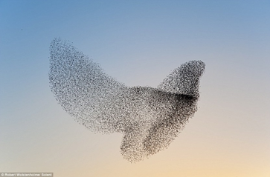
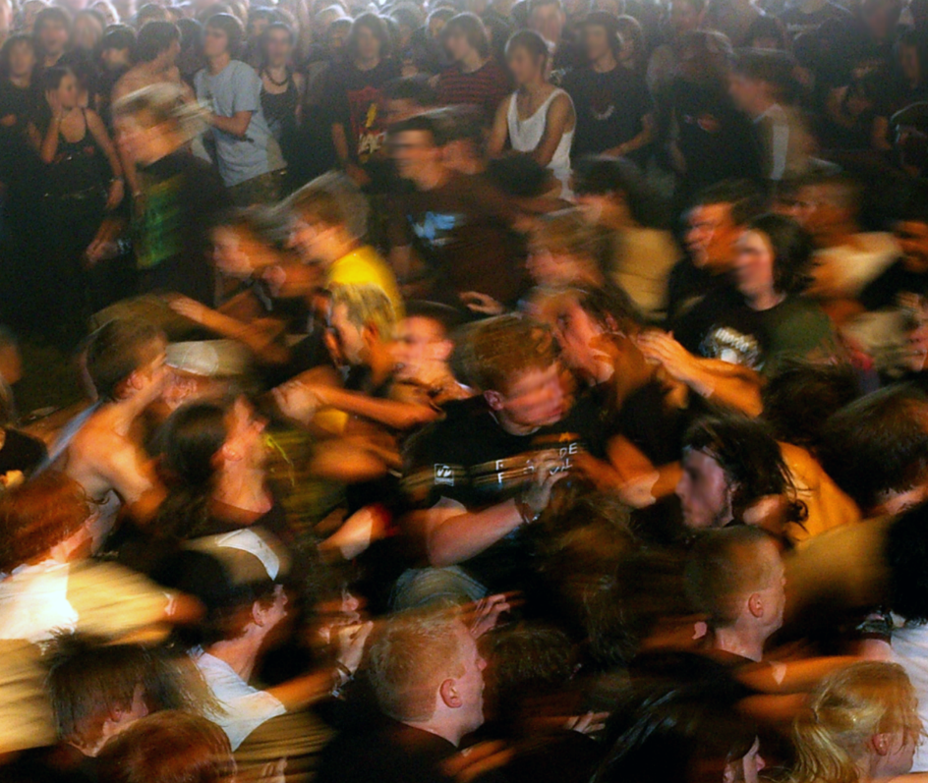
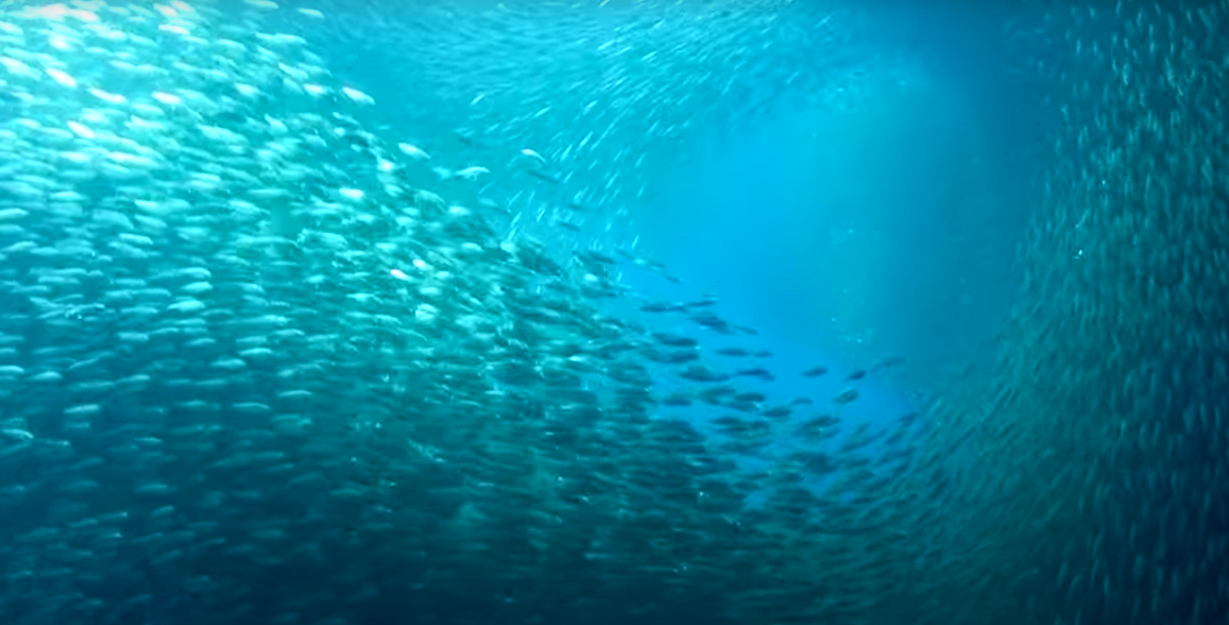
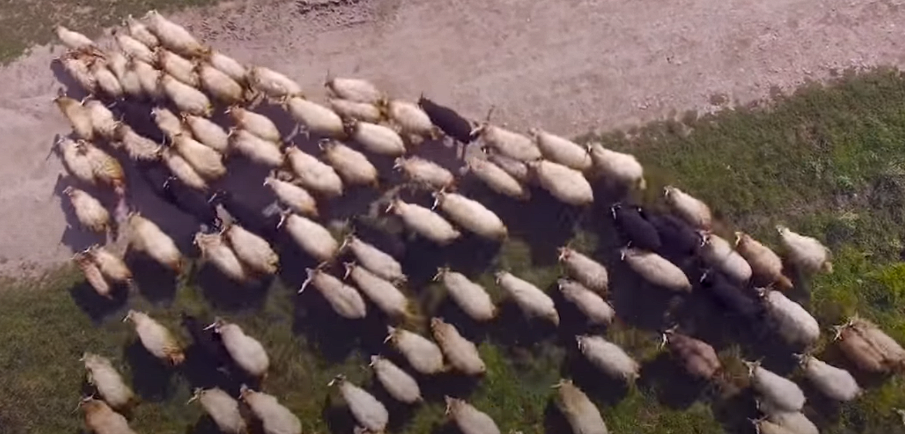
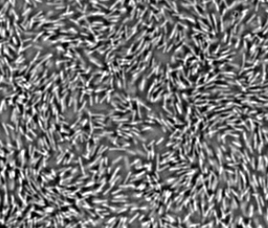
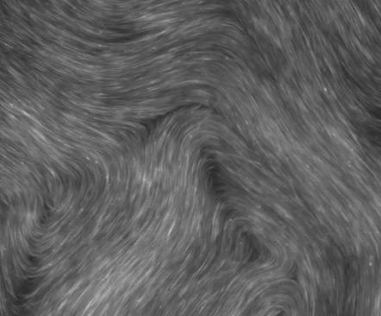
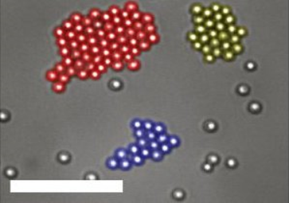
(a)
(b)
(c)
(d)
(e)
(f)
(g)
Notes:
Scalebars in (e) and (g) are 10 \textmu m. Scalebar in (f) is 200 \textmu m. Image courtesy of Robert Wolstenhome (a), Ulrike Biets \cite{Silverberg2013}(b), biographic (c, d), DeCamp \cite{DeCamp2015} (f) and Palacci \cite{Palacci2013} (g).

Slide 2
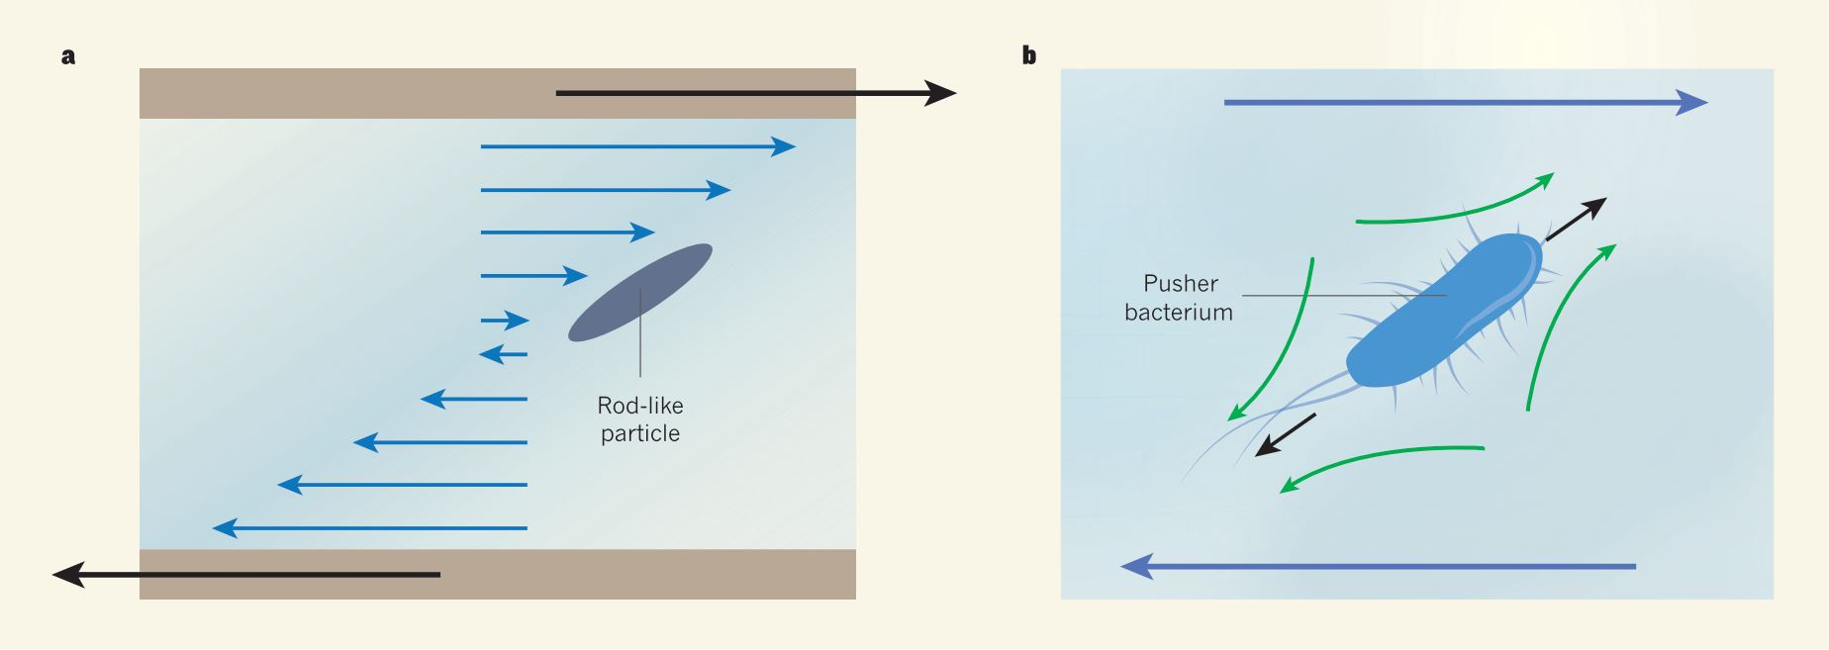
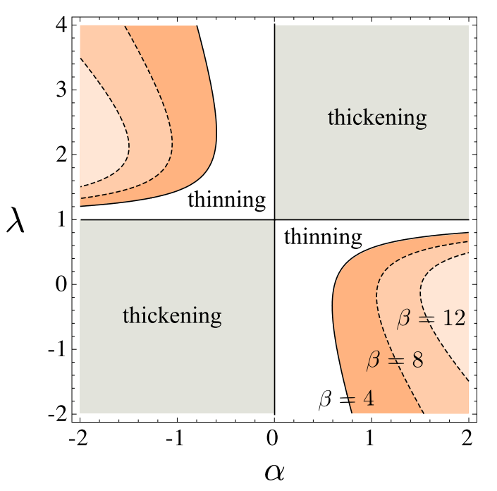
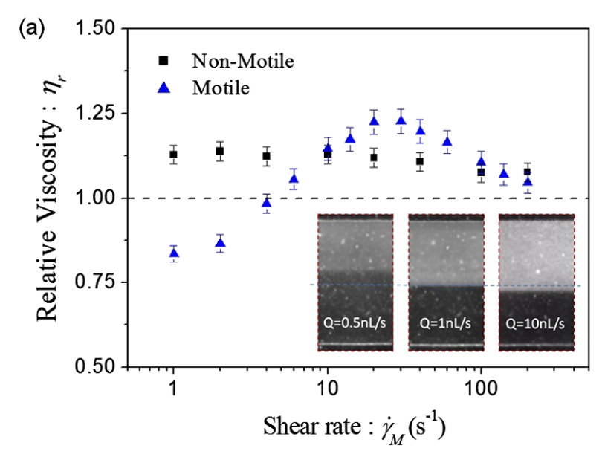
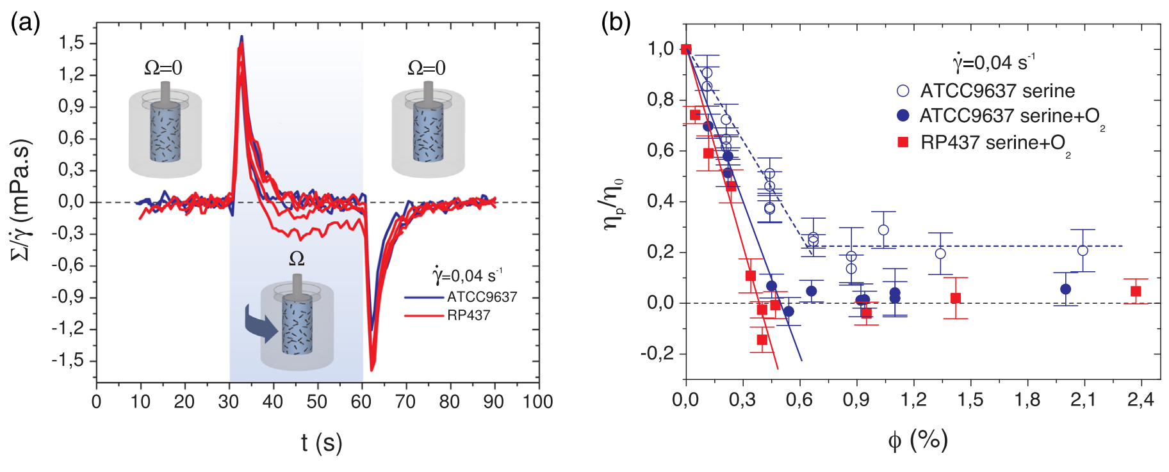
(a)
(b)
Puller algae
(c)
(d)
Rod-like
Disk-like
Pusher
Puller
(e)
(f)
Notes:
the preferred orientation of the bacterium is along the extensile flow.
The most common pushers and pullers in nature: bacterium and algae, and their corresponding far field flow.
rheological effect phase diagram of swimmer shape and swimming mechanism.
Non-Newtonian behavior of \textit{E. coli} suspensions.
Stress response of \textit{E. coli} suspensions in a modified Couette concentric cylinder rheometer.
Viscosity of \textit{E. coli} suspensions at various volume fractions.
Image courtesy of Marchetti (a, b) \cite{Marchetti2015}, Giomi (c) \cite{Giomi2010}, Gachelin (d) \cite{Gachelin2013} and Lopez (e, f) \cite{Lopez2015}.

Slide 3
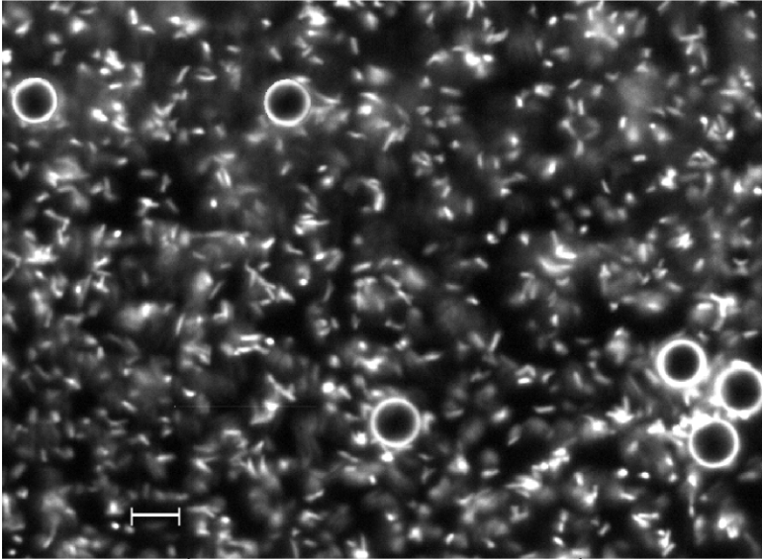
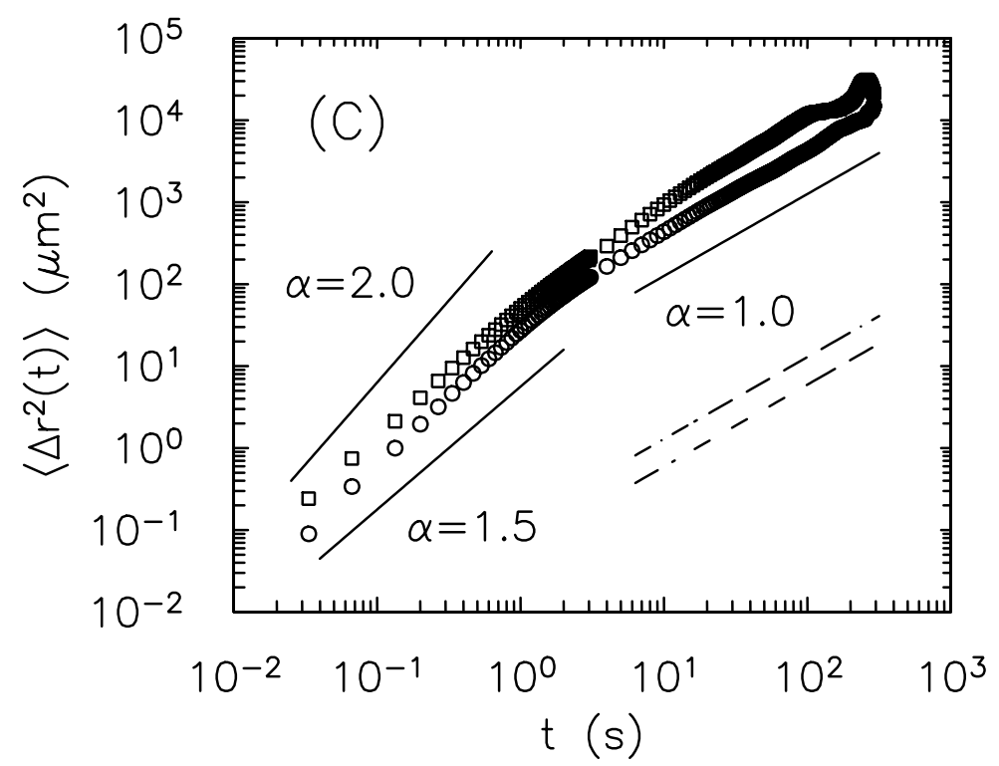
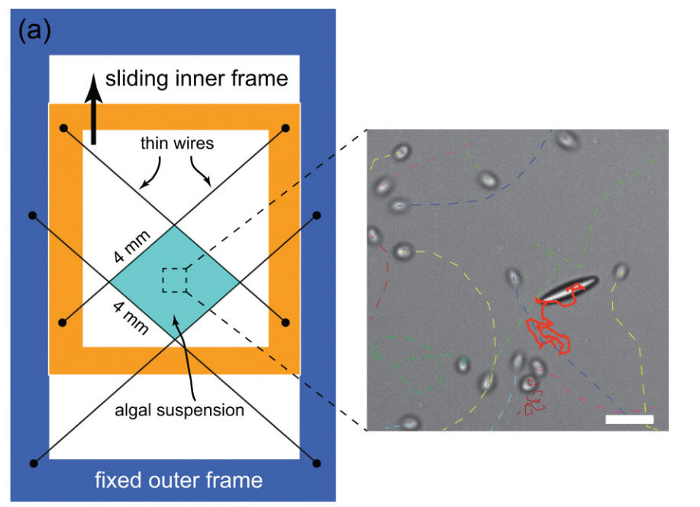
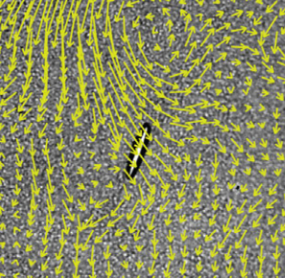
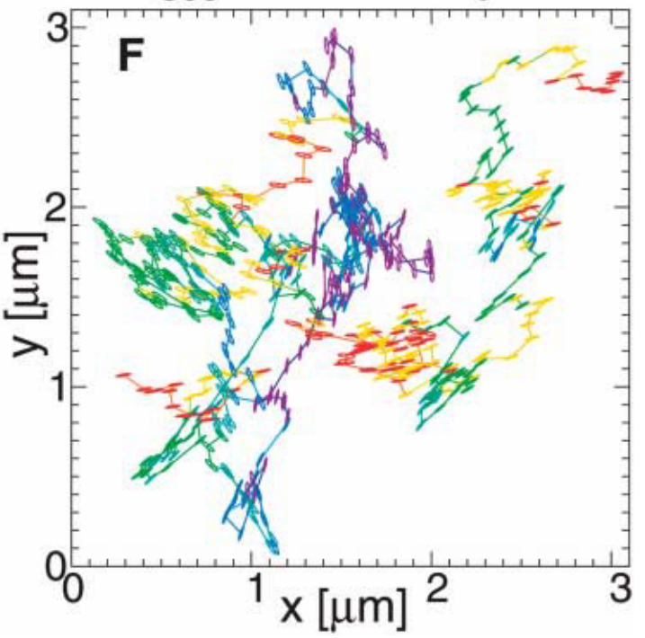
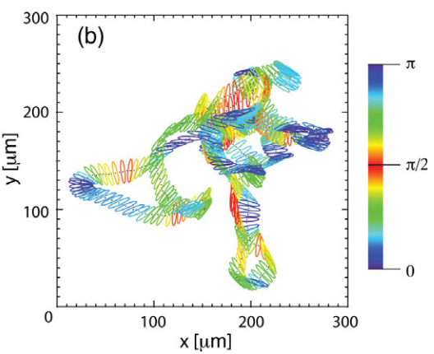
(a)
(b)
(c)
active bath
(d)
(e)
Notes:
10 \textmu m diameter PS particles suspended in a bath of \text{E. coli}
Mean squared displacement (MSD) of tracer paticles as a function of lag time.
Free-standing film setup adopted by Peng et al. and Yang et al. (left)\cite{Peng2016, Yang2016}. A microscopic image of ellipsoidal PS particle suspending in \textit{C. reinhardtii} (middle) and \textit{E. coli} (right) baths. Scale bar: 20 \textmu m.
(d) and (e) present both the translational and orientational trajectories of ellipsoids diffusion in water and \textit{E. coli} bath, respectively.
Image courtesy Wu (a, b) \cite{Wu2000}, Yang (c) \cite{Yang2016}, Han (d) \cite{Han2006} and Peng (e) \cite{Peng2016}.

Slide 4
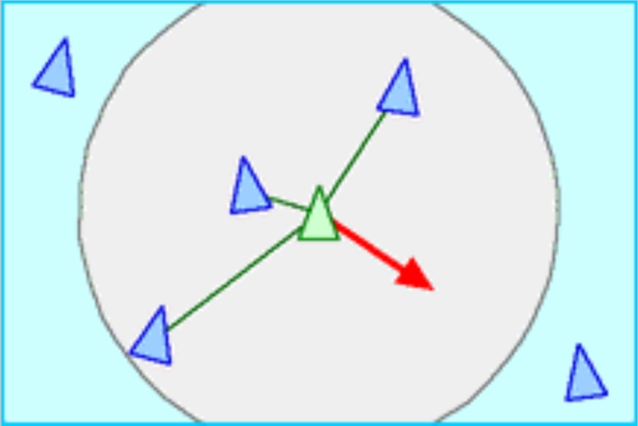
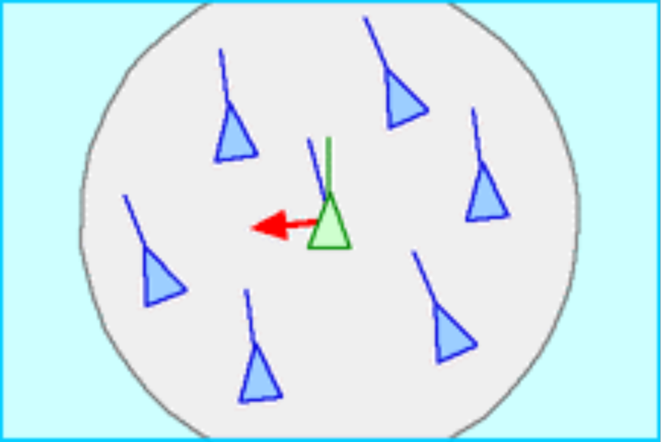
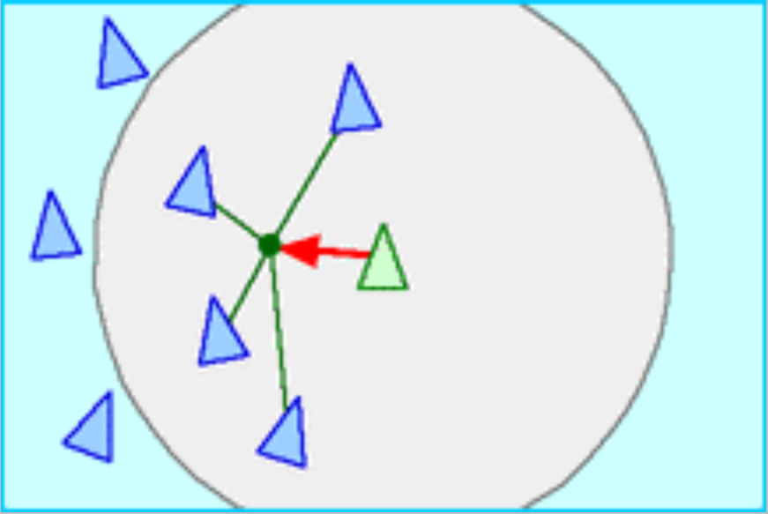
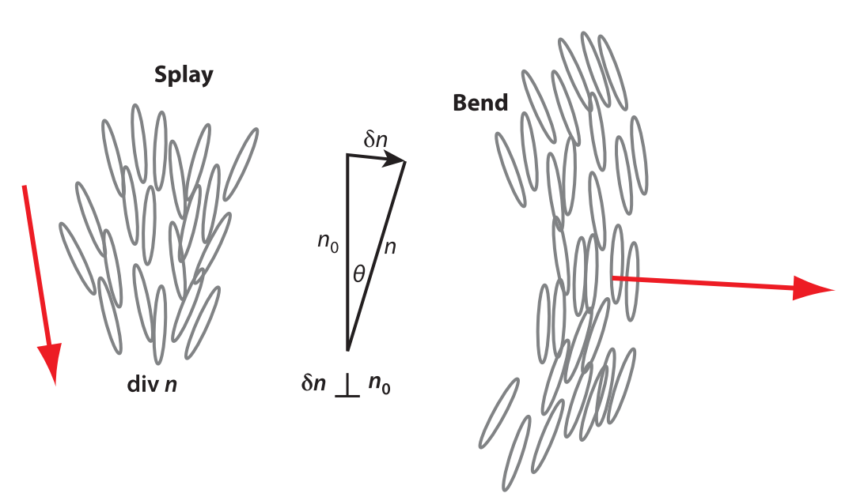
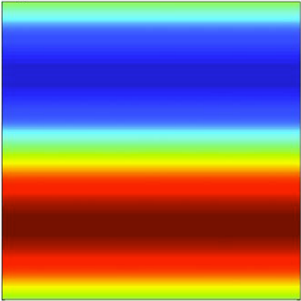
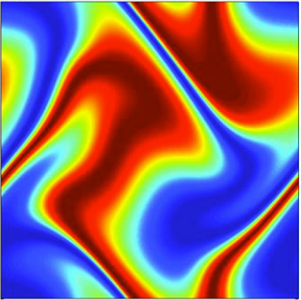
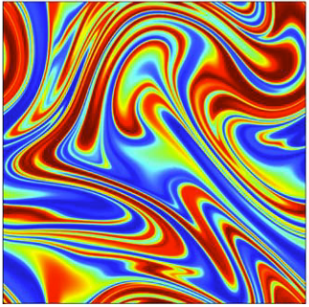
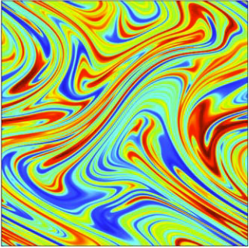
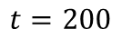
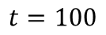
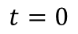
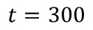
(a)
(b)
(c)
(d)
(e)
$$t=0$$
$$t=100$$
$$t=200$$
$$t=300$$
Notes:
Illustrations of existing models and theories of collective motions.
(a)-(c) Reynolds’ “boids” model obeying the rules of separation (a), alignment (b) and cohesion (c)
(d) Nematic self-propelled particle model, displaying splay (left) and bend (right) instability
(e) Simulation of efficient fluid mixing driven by active pusher swimmers.
Image courtesy of Reynolds (a-c) \cite{Reynolds1987}, Ramaswamy (d) \cite{Ramaswamy2010} and Saintillan (e) \cite{Saintillan2008b}.

Slide 5
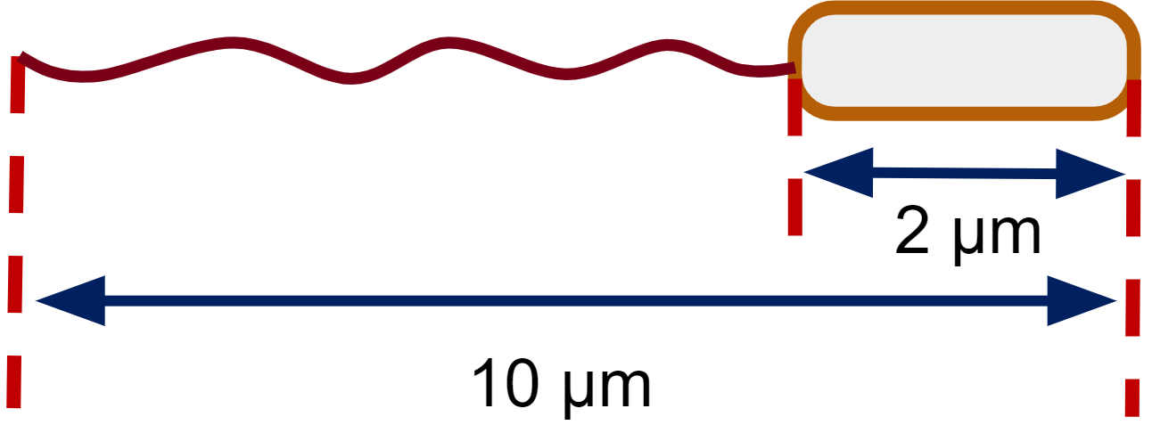
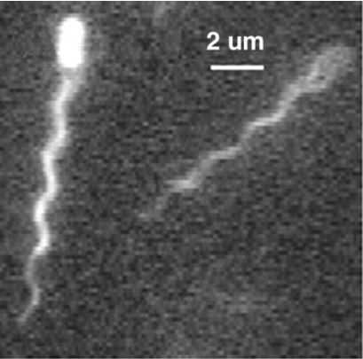
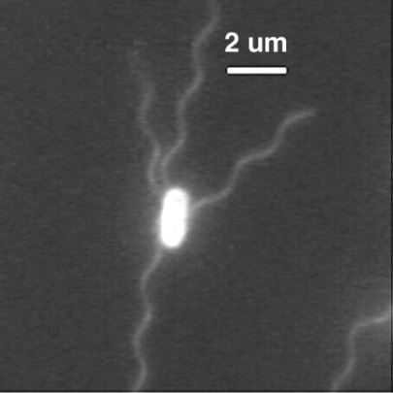
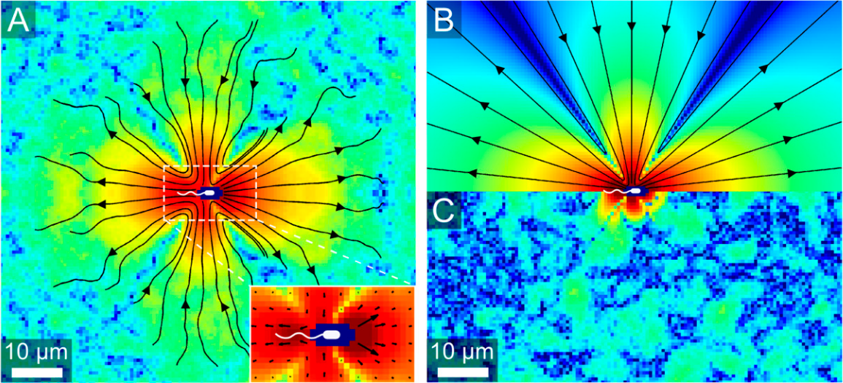
(a)
(b)
(c)
(d)
(e)
Notes:
Model swimmer \textit{Escherichia coli}.
A schematic of a swimming \textit{E. coli} bacterium.
Fluorescence microscopic image of swimming \textit{E. coli} with bundled flagella.
Fluorescence microscopic image of tumbling \textit{E. coli} with unbundled flagella.
Flow field around a swimming \textit{E. coli}, measured with suspending microspheres.
Best-fit force dipole flow for the flow field shown in (d).
Image sources:
(b) and (c) are reproduced from Fig. 4a and 2a in Ref.~\cite{Turner2000} with permission from XXX.
(d) and (e) are reproduced from Fig. 1a and 1b in Ref.~\cite{Drescher2011} with permission from XXX.

Slide 6
Notes:
\textbf{Graphical motile \textit{E. coli} sample preparation protocol.}
Image courtesy of Shashank Kamdar.

Slide 7
microscope
filters
Bottom filter block
Add ND filter
Notes:
Fig 2.3 Nikon Ti-E inverted microscope and its filters.
Nikon Ti-E inverted microscope model.
Illumination light path filters.
Filter block under objective.
Adding additional ND filter under objective.

Slide 8
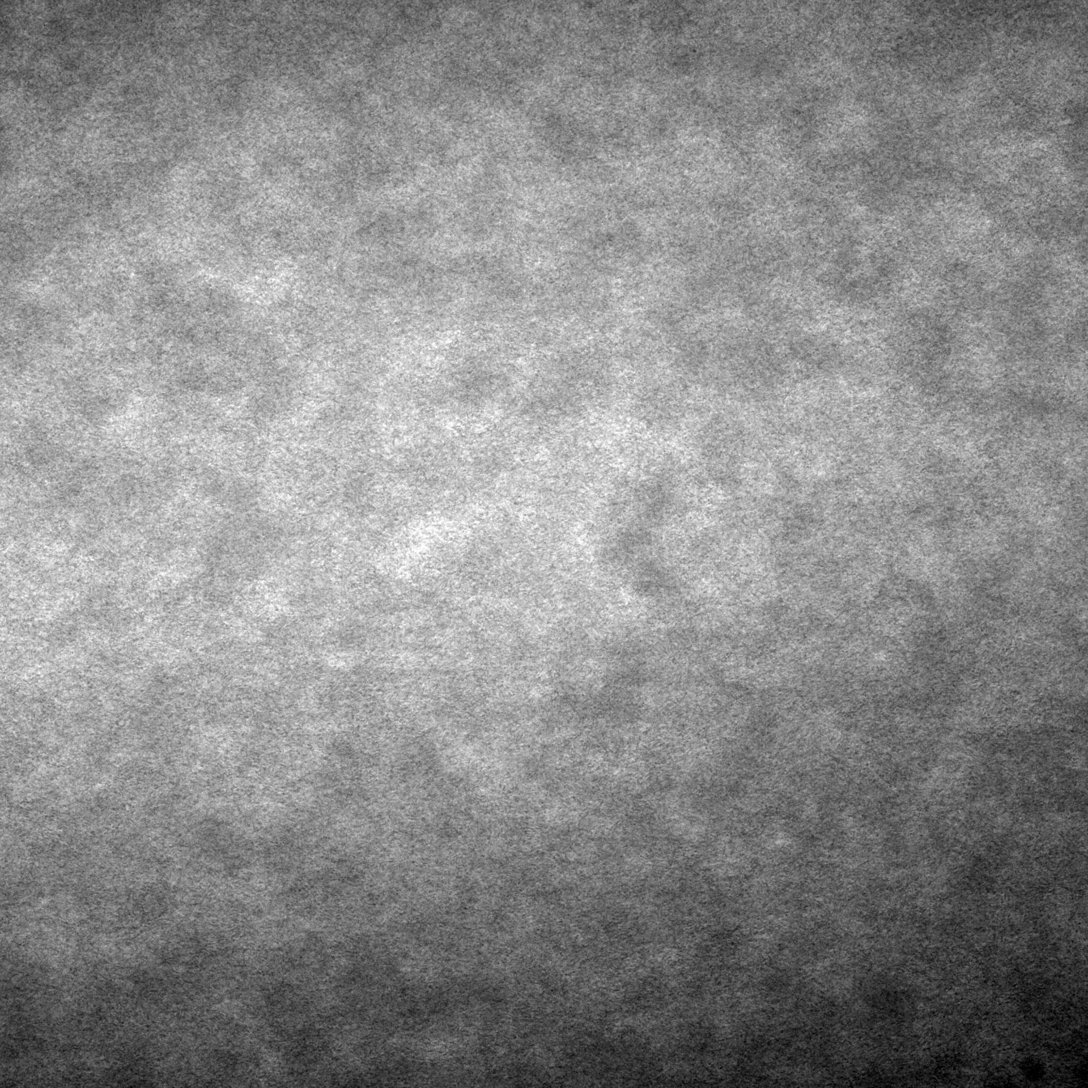
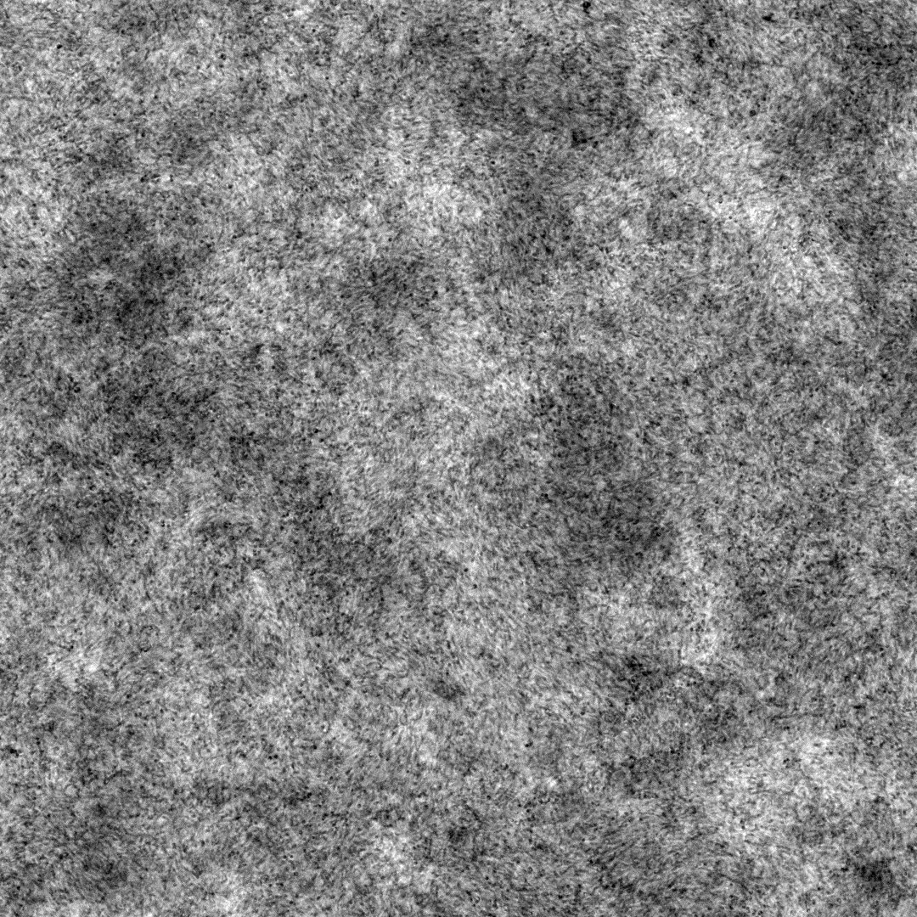
(a)
(b)
Long-wave inhomogeneity
Uniform
illumination
Notes:
Figure 2.4
Image with (a) and without (b) the diffusion filter (D).

Slide 9
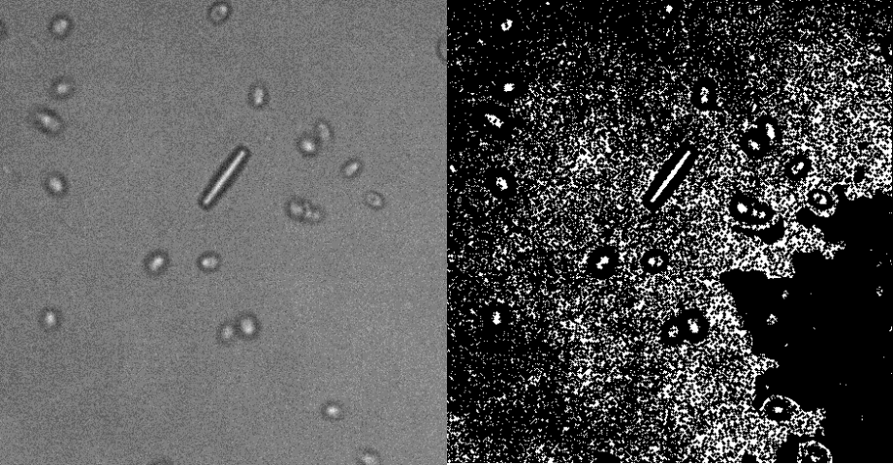
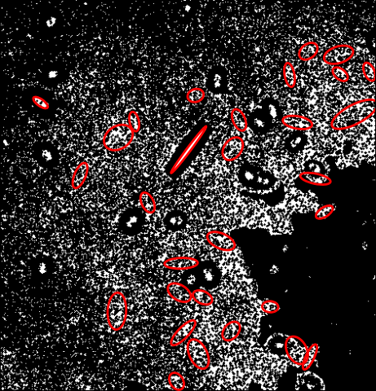
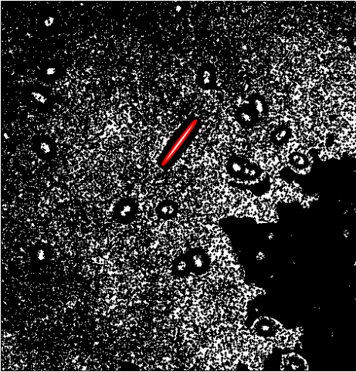
(a)
(b)
(c)
(d)
Notes:
Figure 2.5 Illustration of ellipsoidal particle detection by thresholding and group labeling.
The raw image: an ellipsoidal polystyrene particle surrounded by swimming algae in a suspension.
Binarized raw image.
Detection result of connected white regions.
Final result after appropriate filtering.

Slide 10
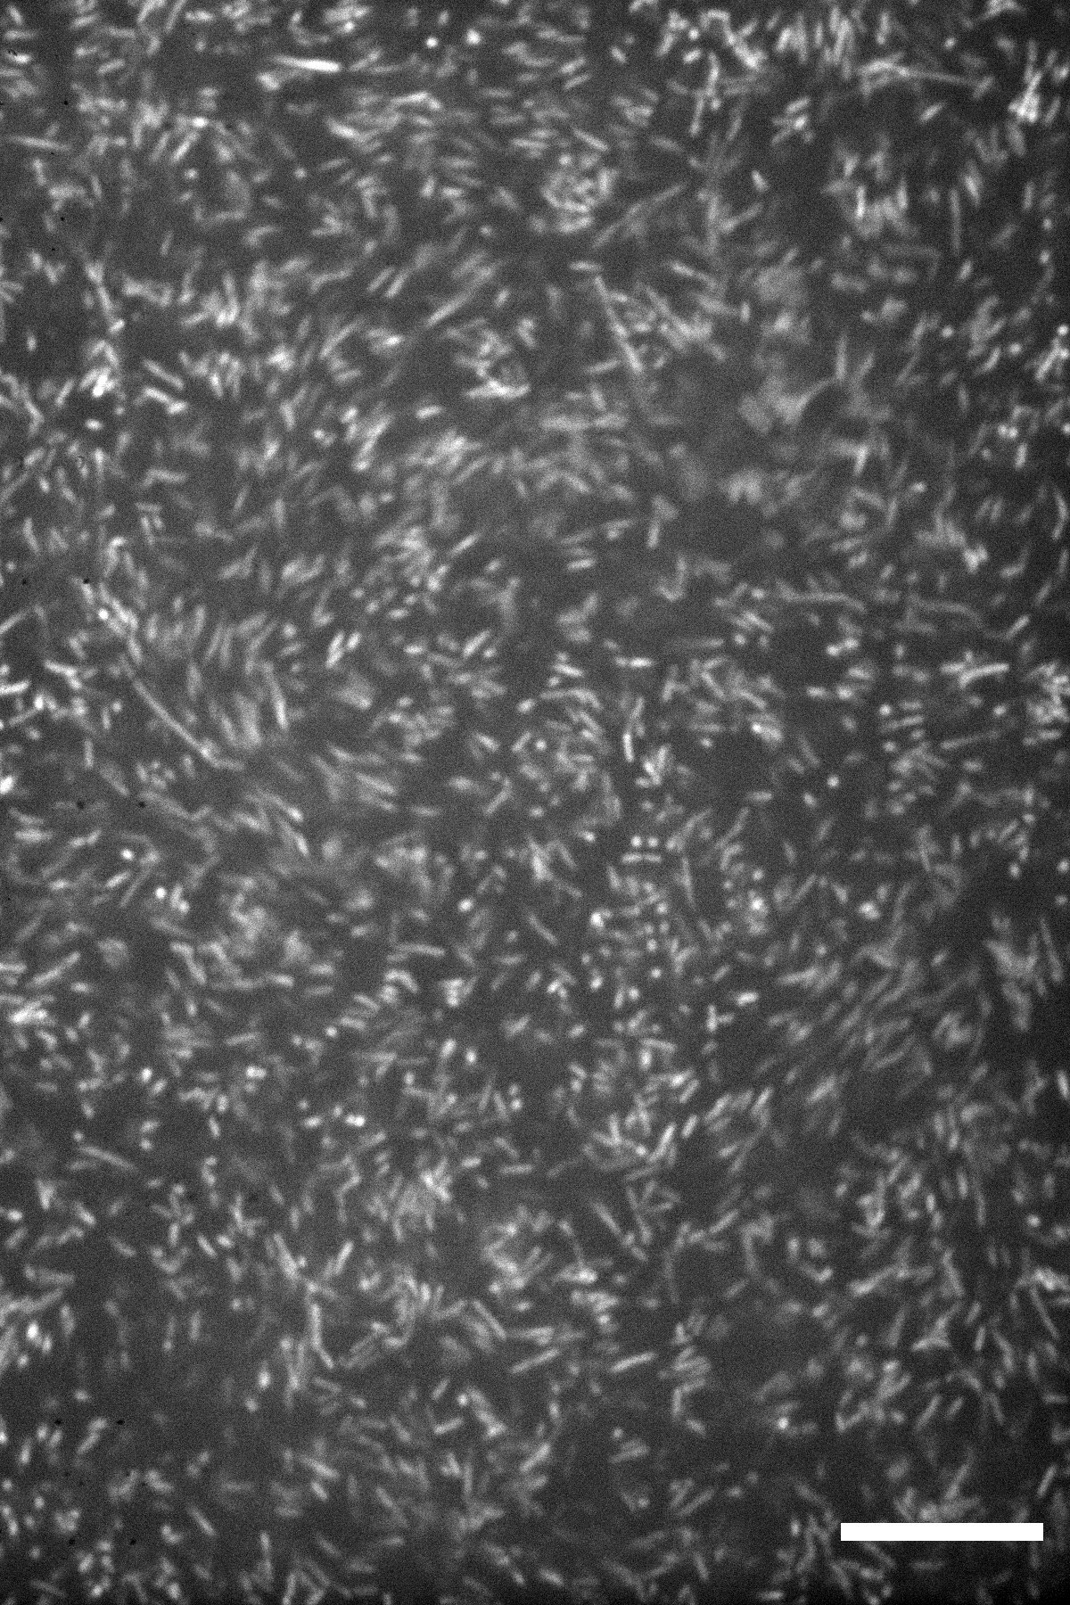
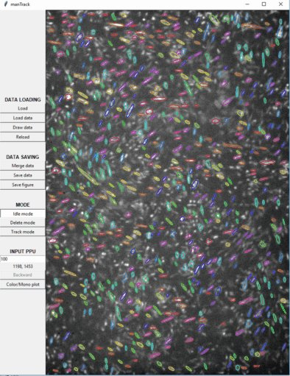

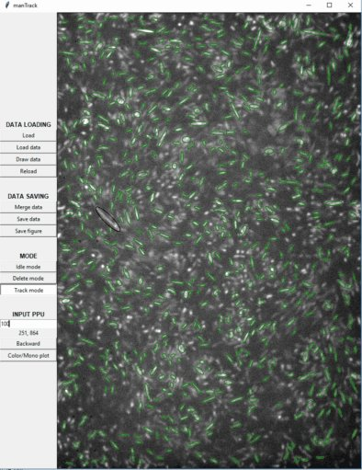
(a)
(b)
color-coded orientation
(c)
(d)
delete
add
Notes:
Figure 2.6 A challenging particle detection task and the manual tracking software.
Confocal microscopy image of \textit{E. coli} collective motion ($\phi=6.4\%$).
(b)-(d) Snapshots of the manTrack software, demonstrating color-coded orientation, manual deleting and manual adding.

